Slide 1
New Technology: Raspberry Pi - Python
Didier De Maeyer

Slide 2
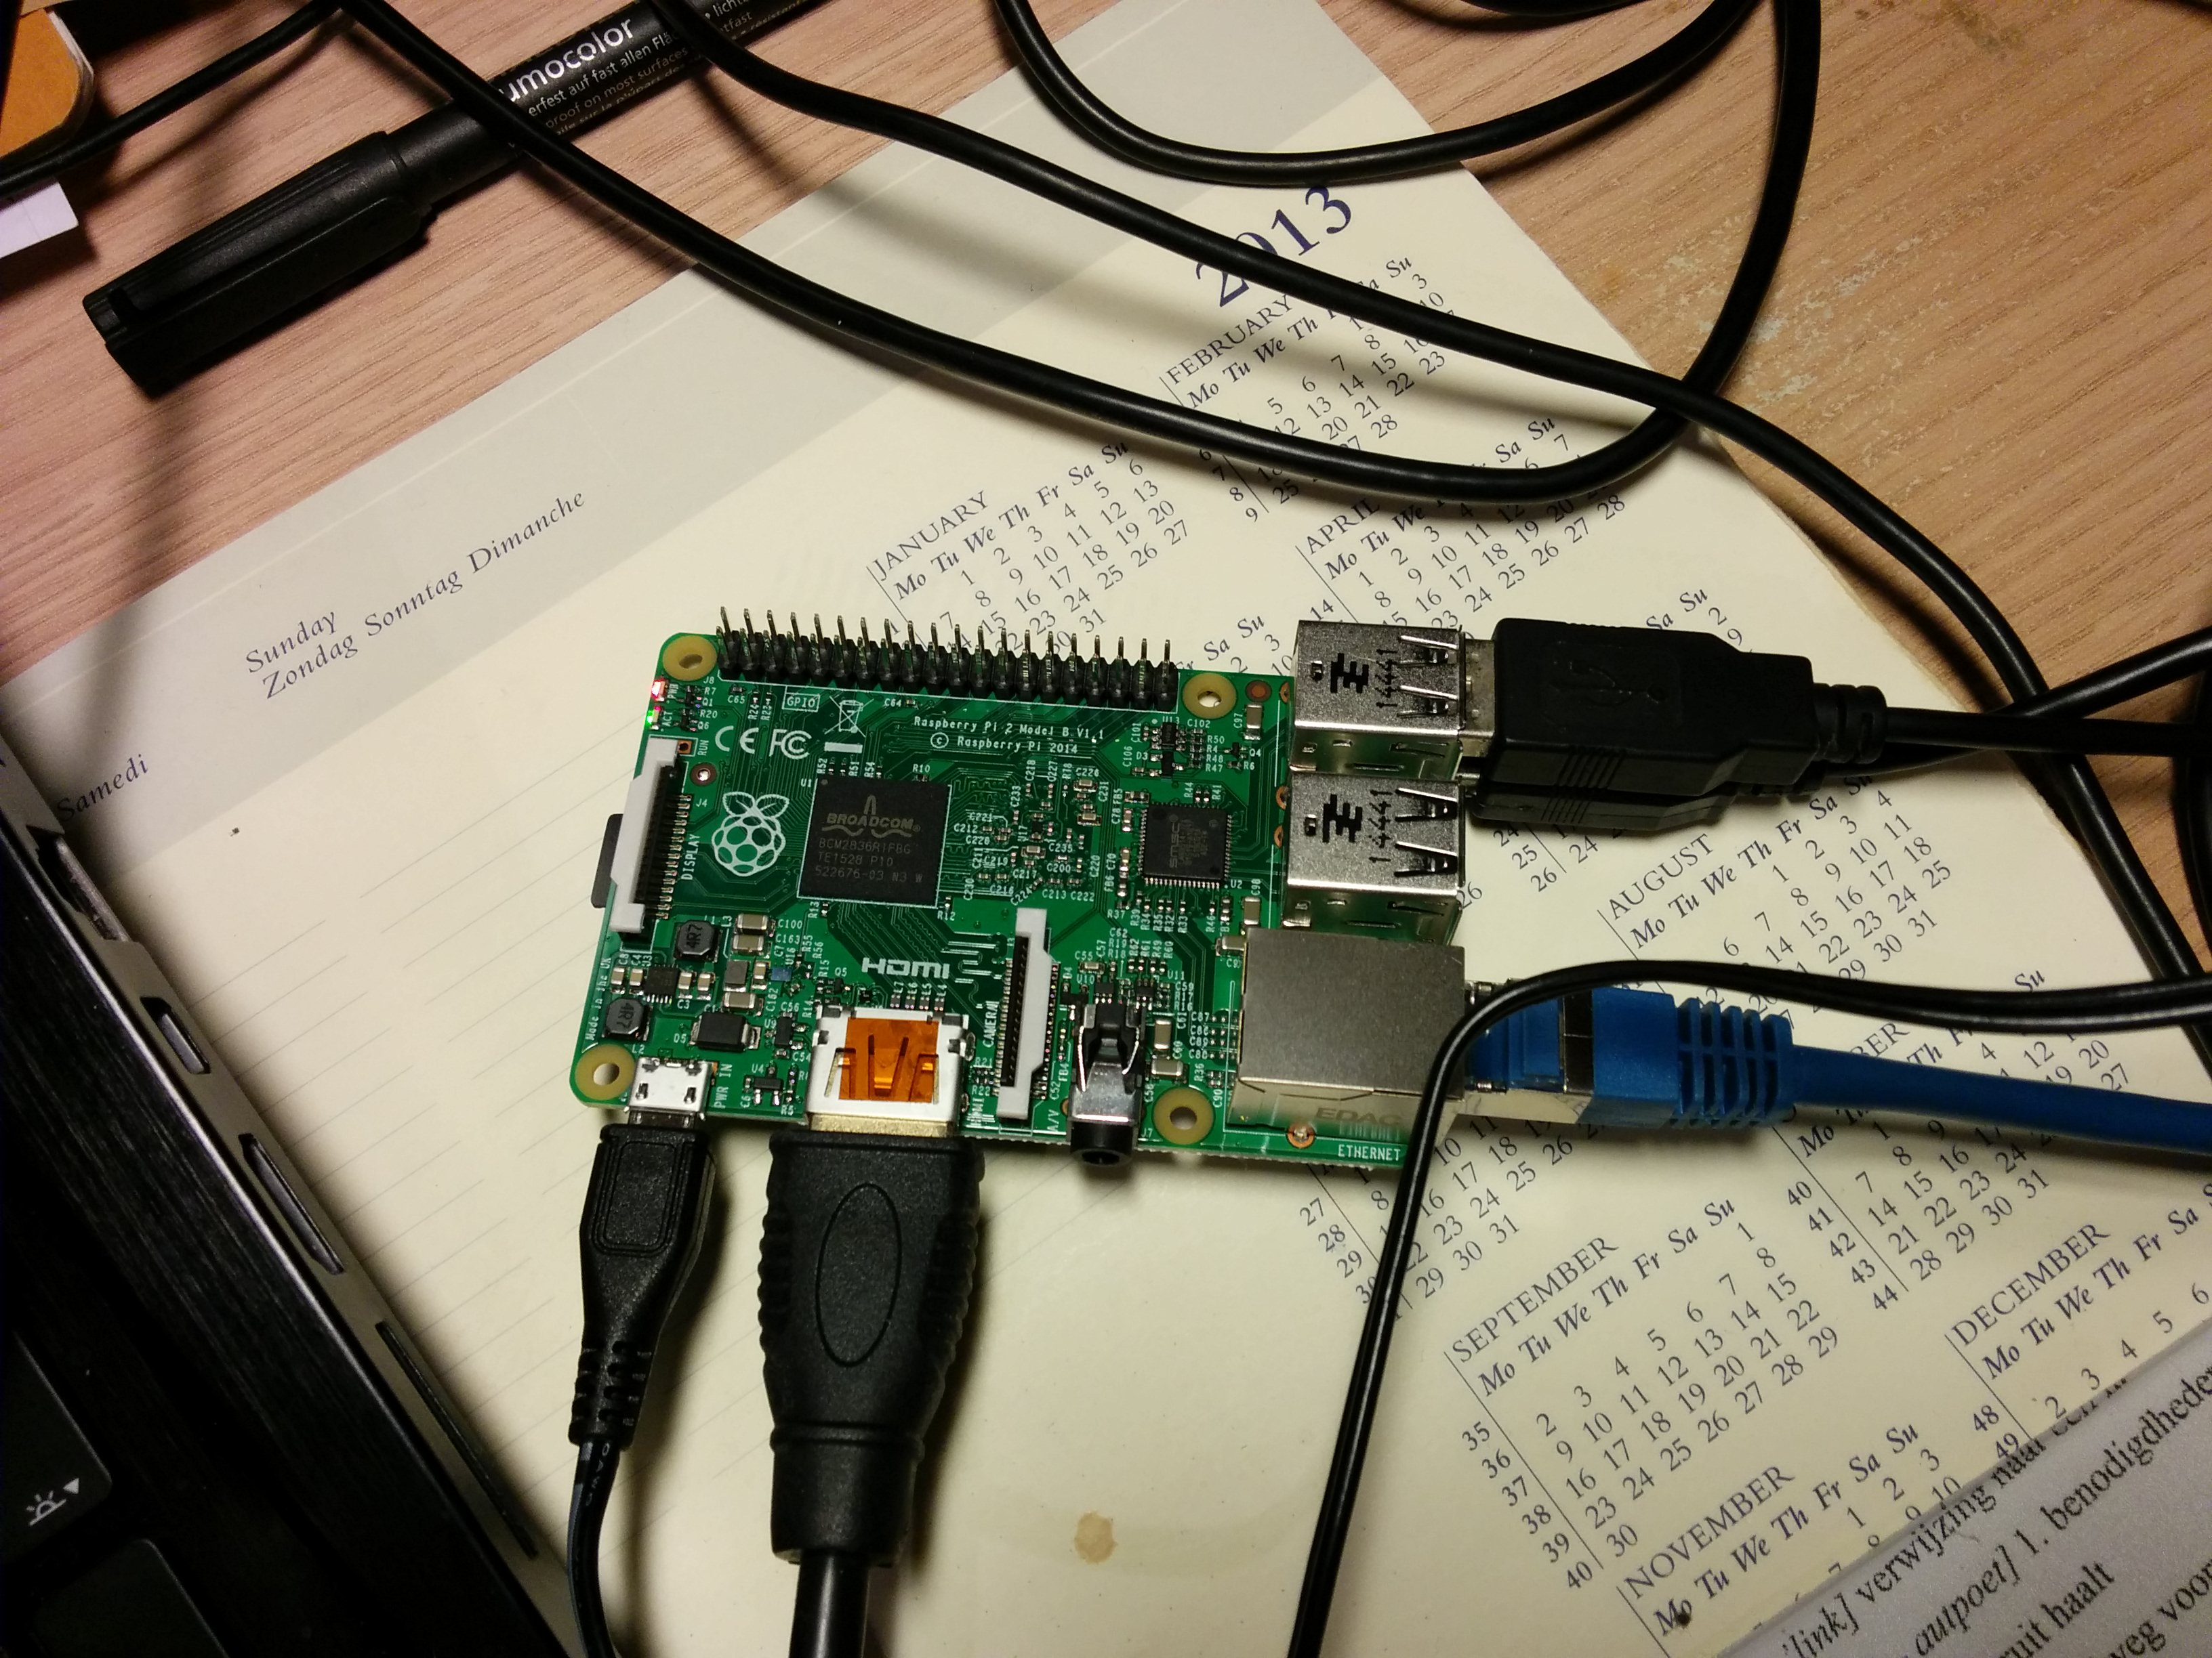
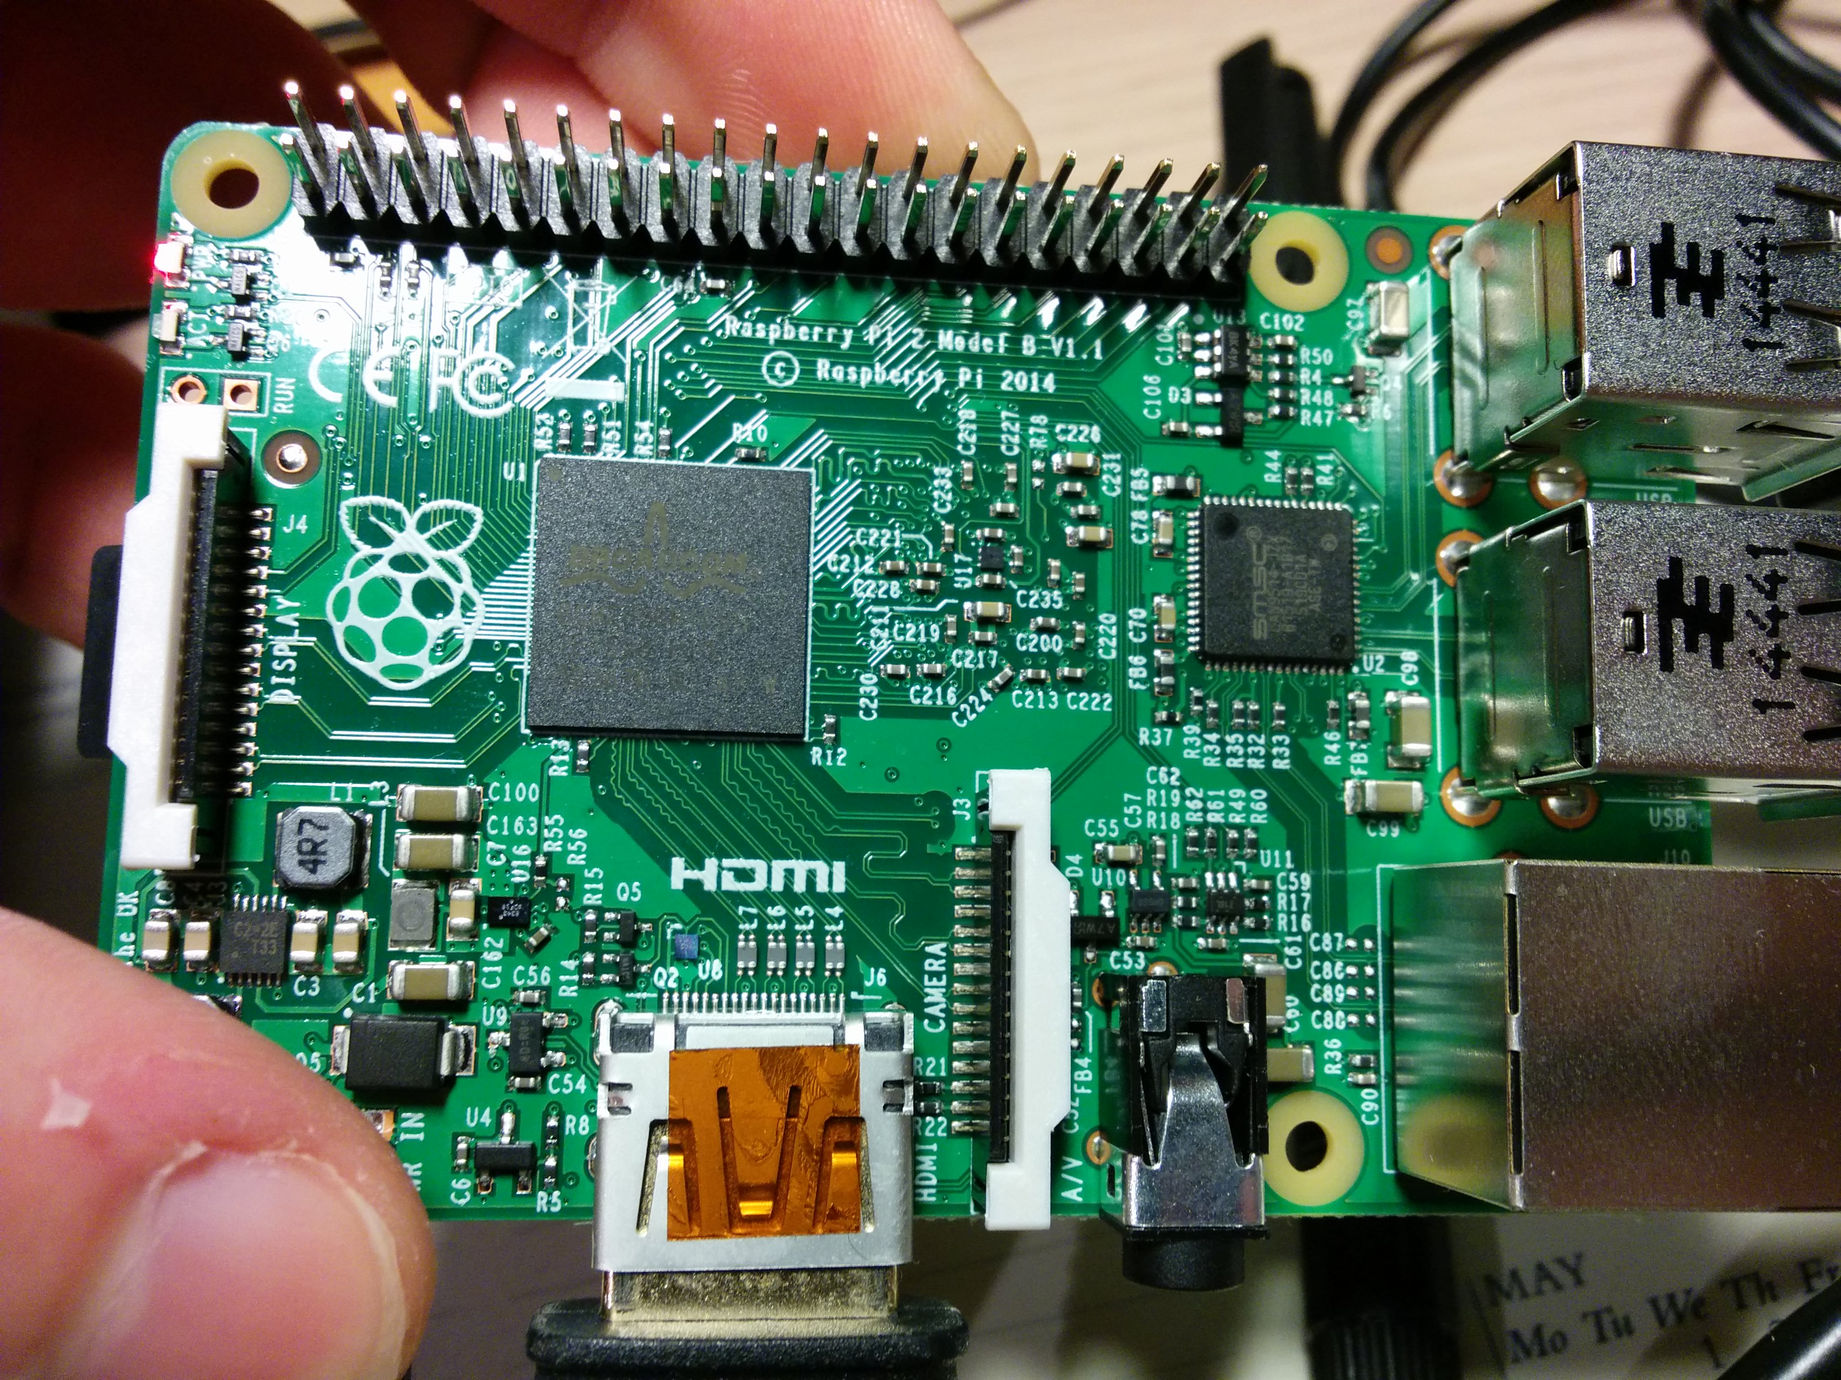
Installatie Raspberry Pi

Slide 3
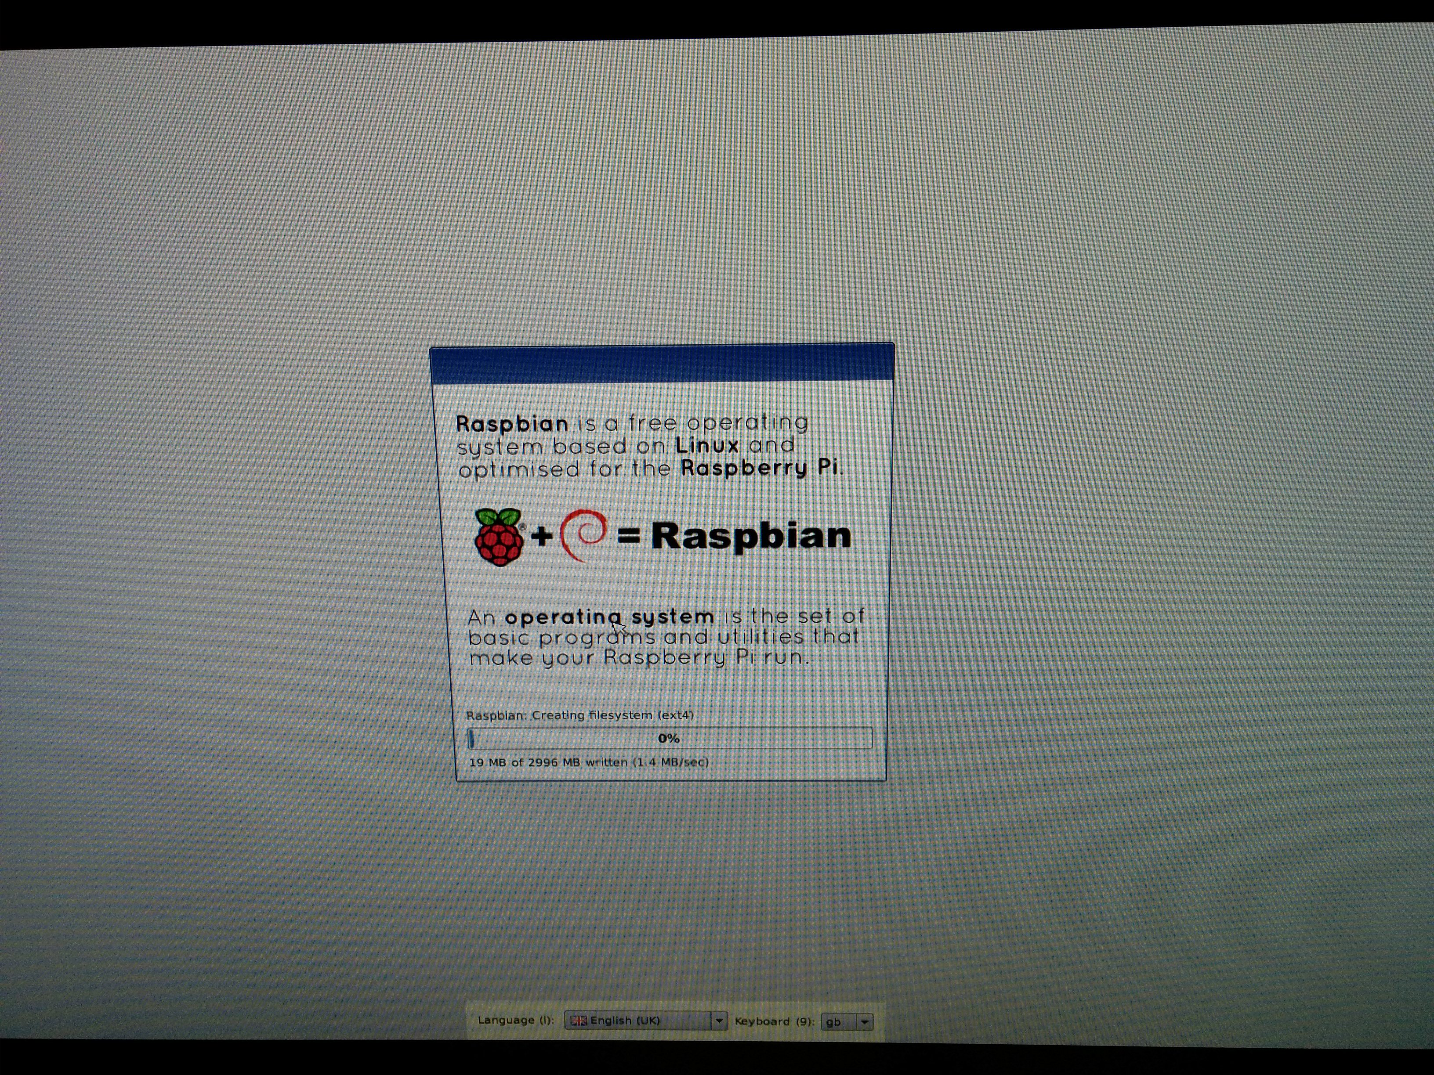
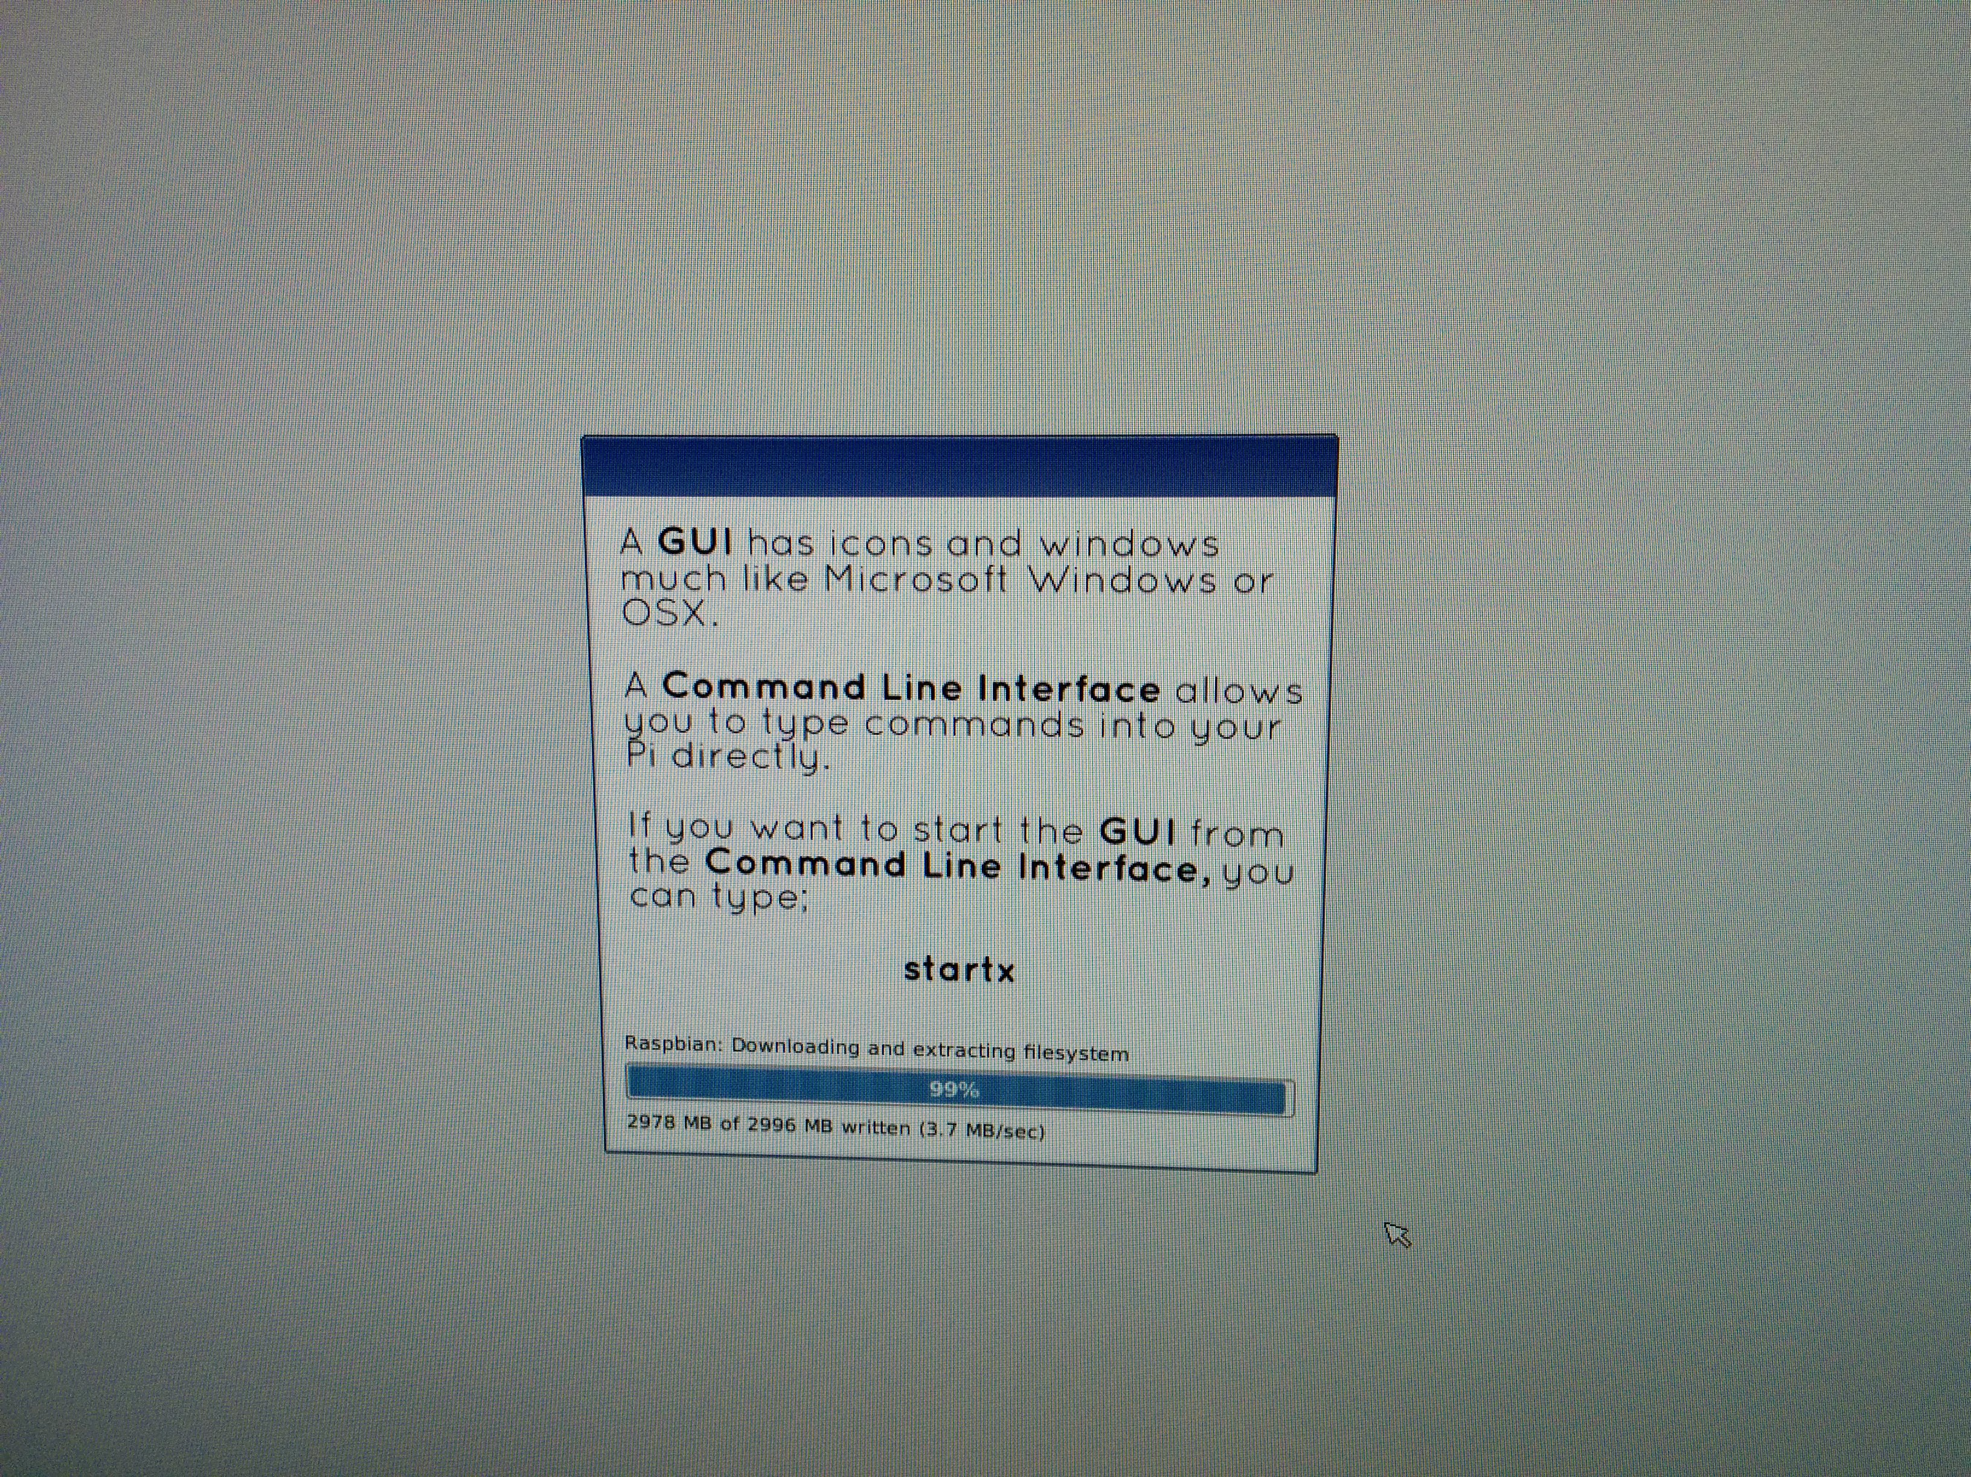
Installatie Raspberry Pi

Slide 4
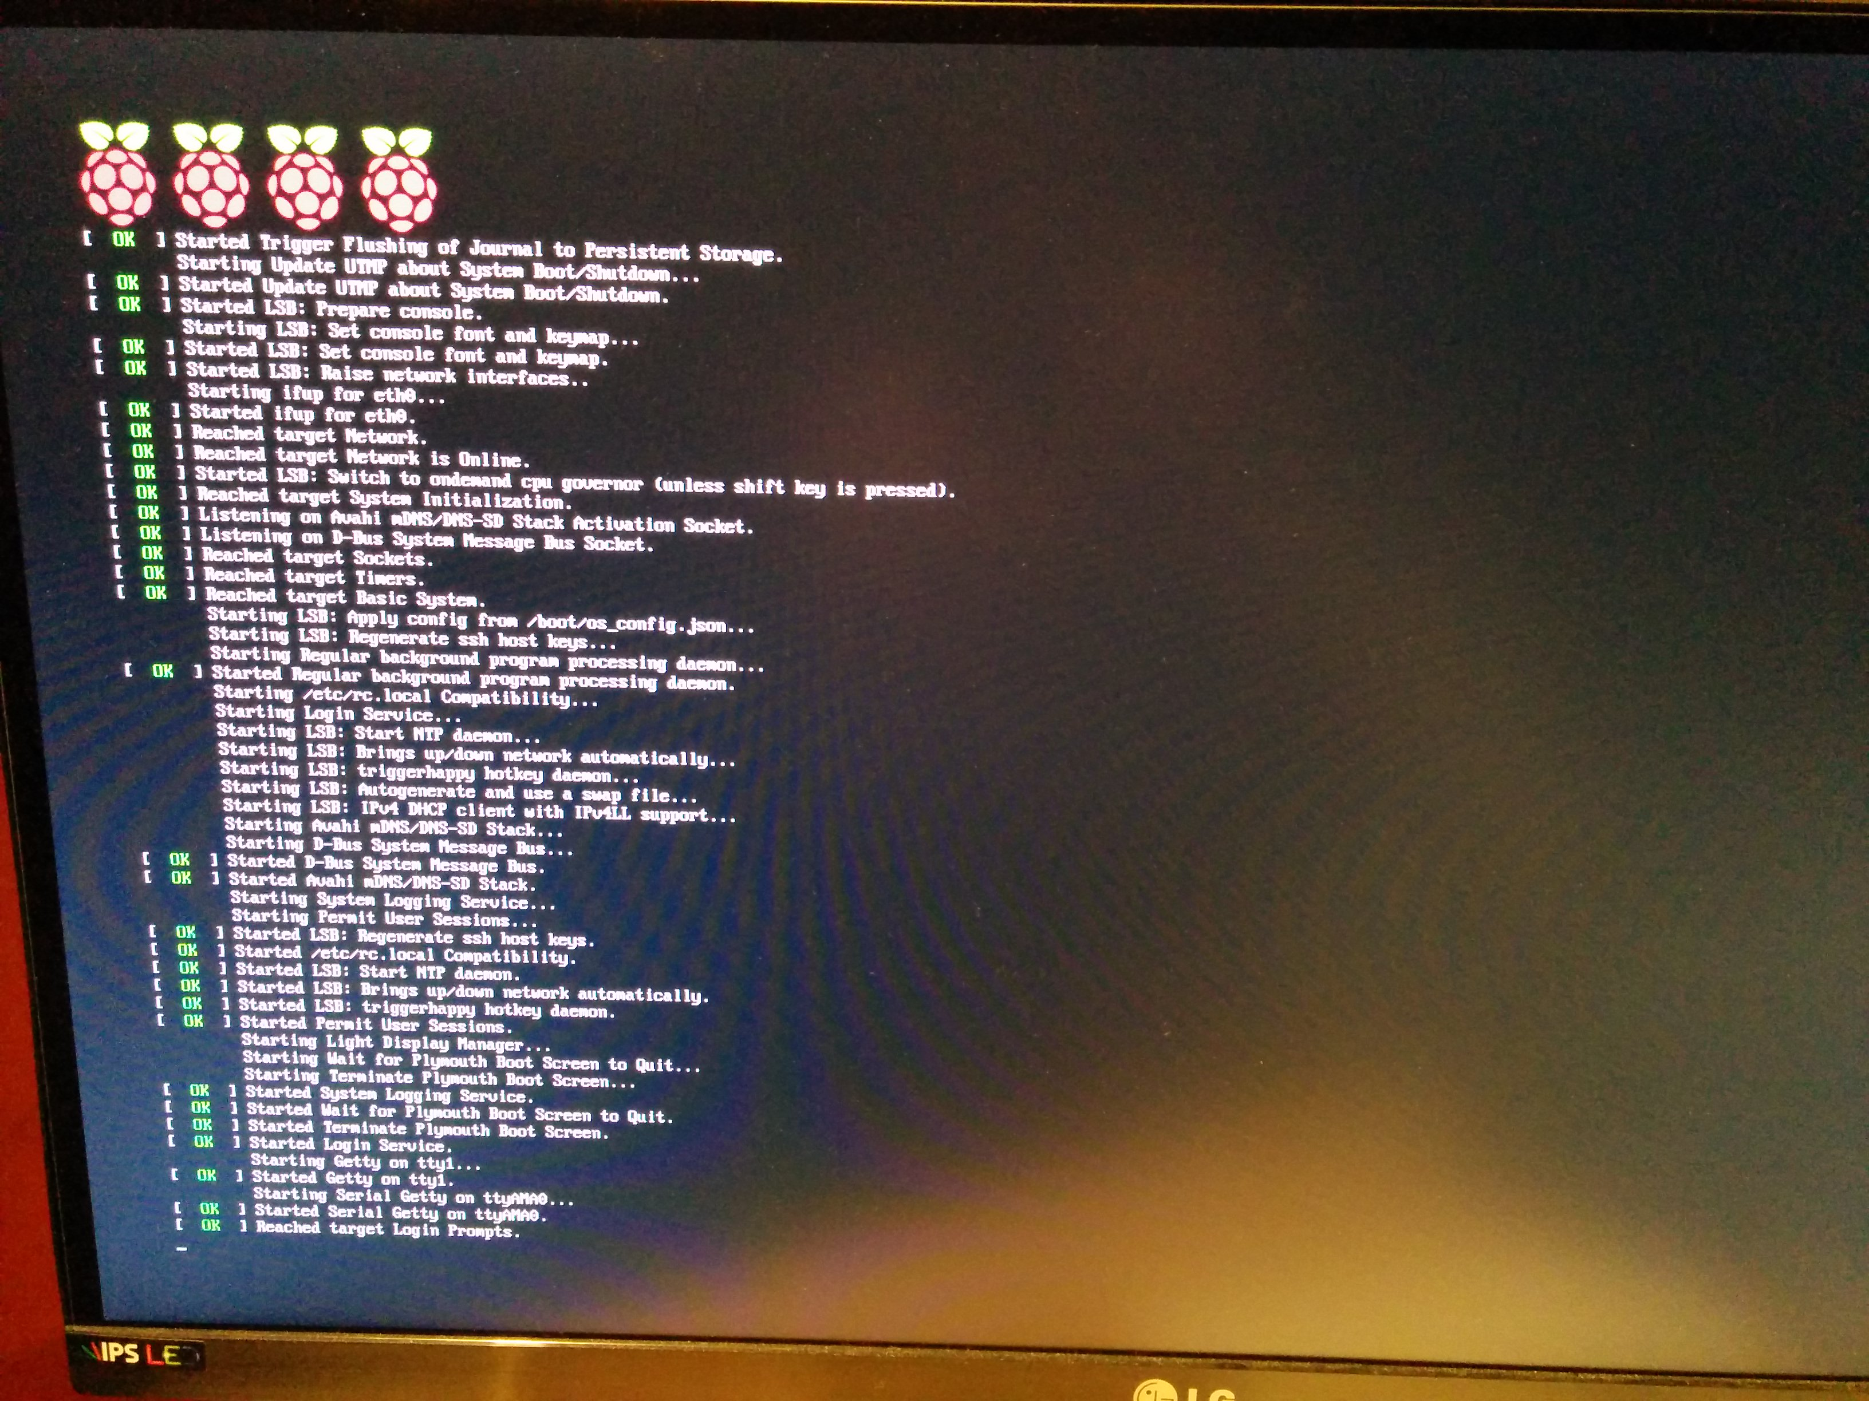
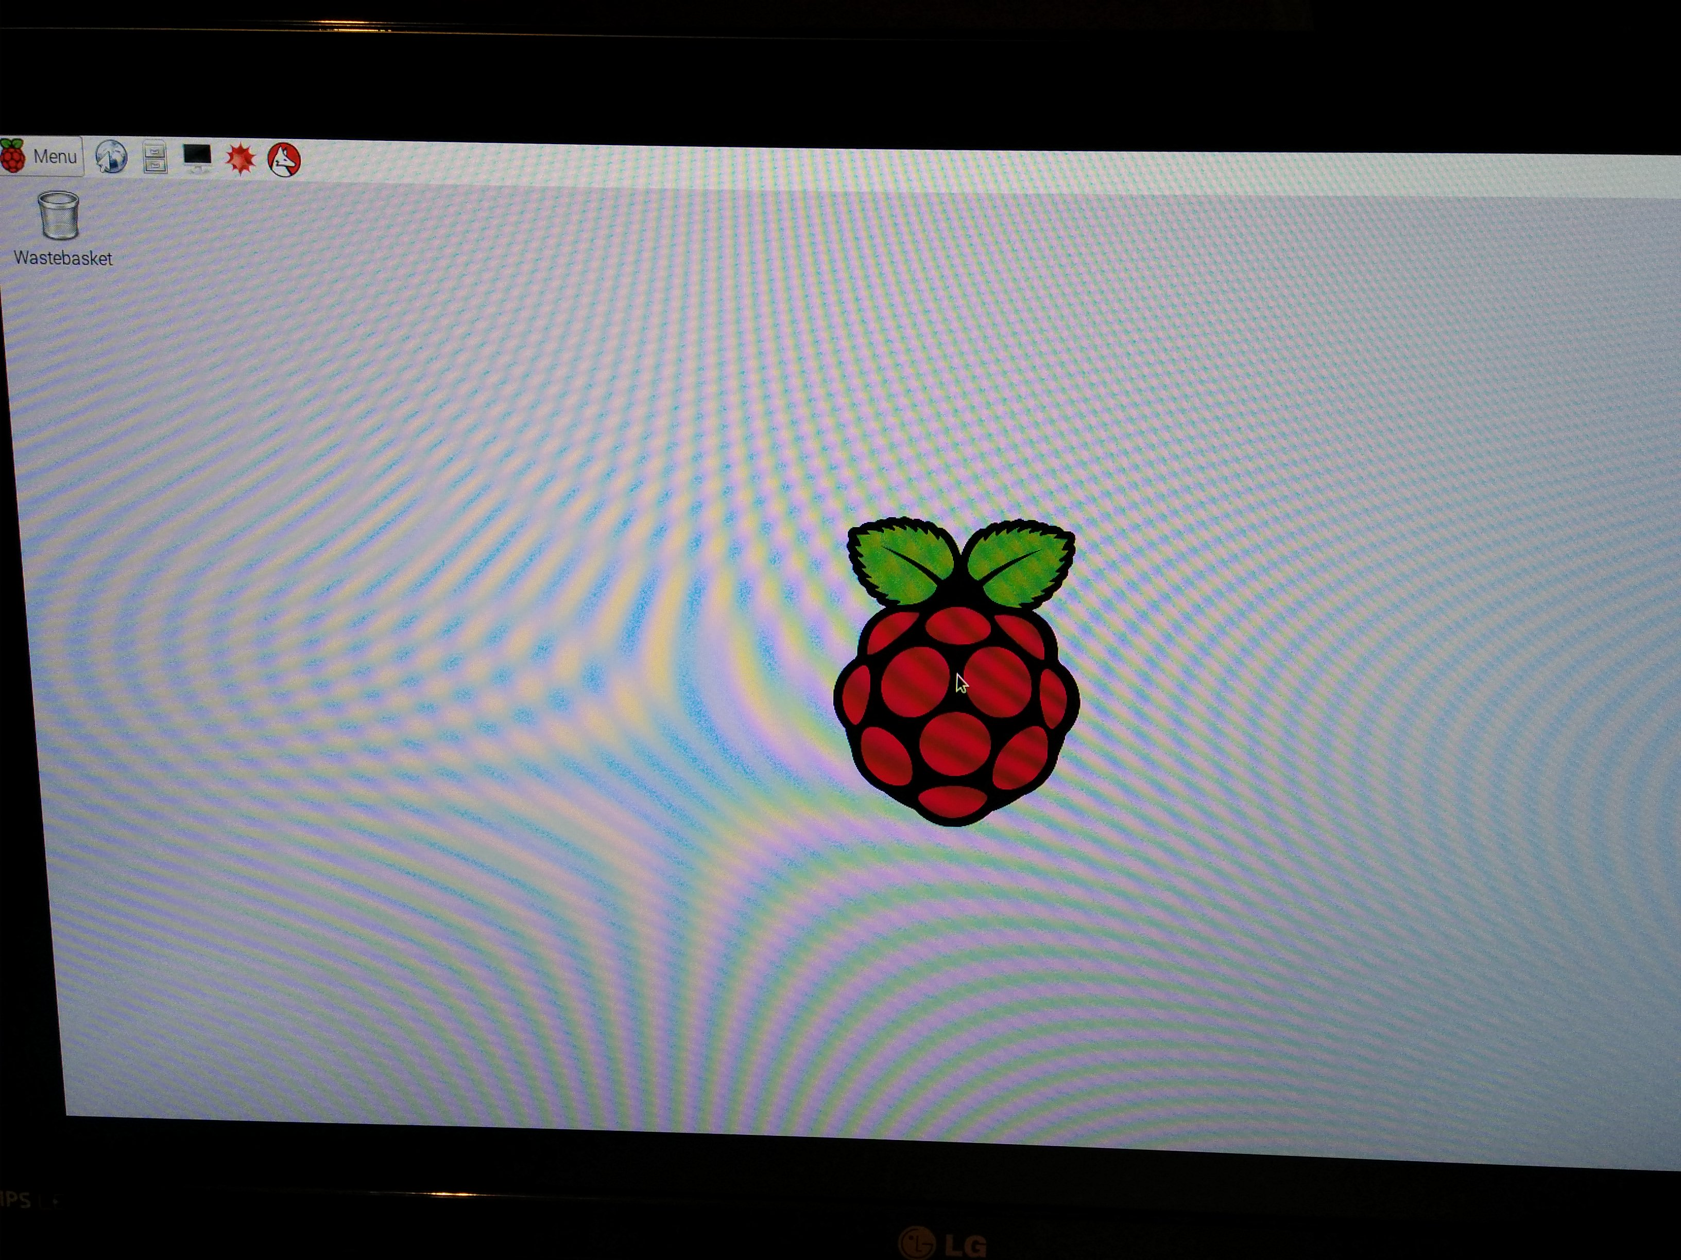
Raspberry Pi

Slide 5
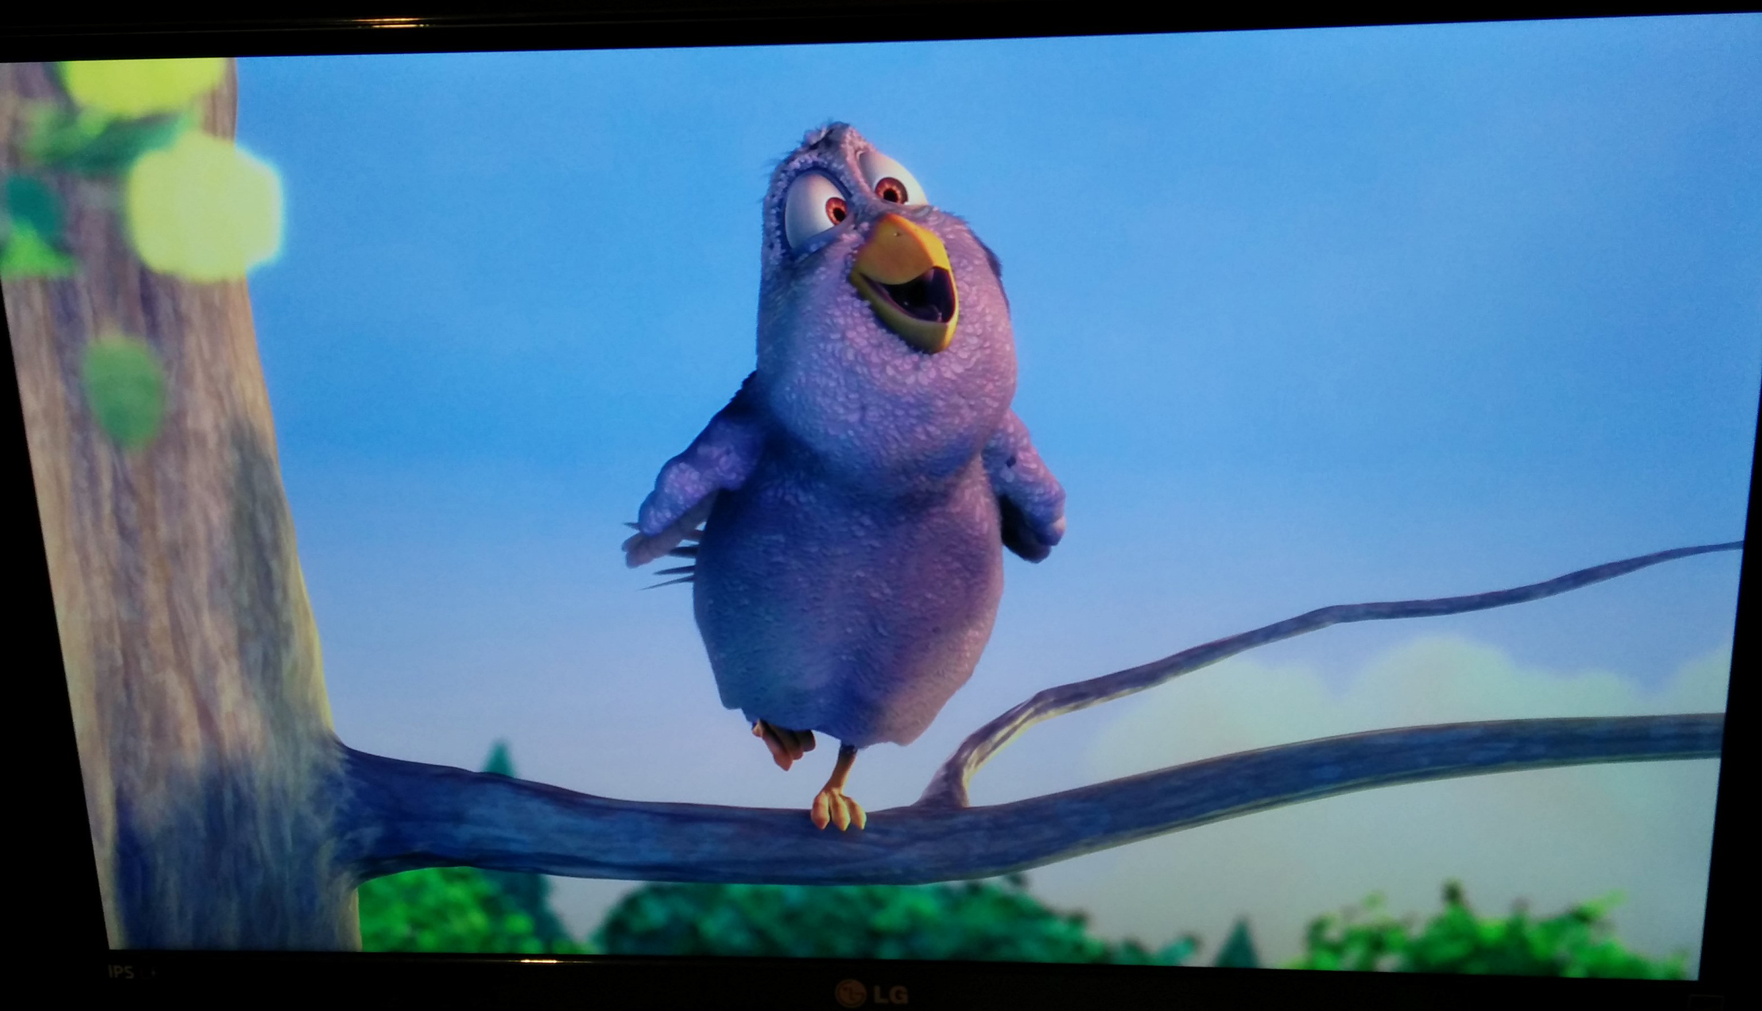
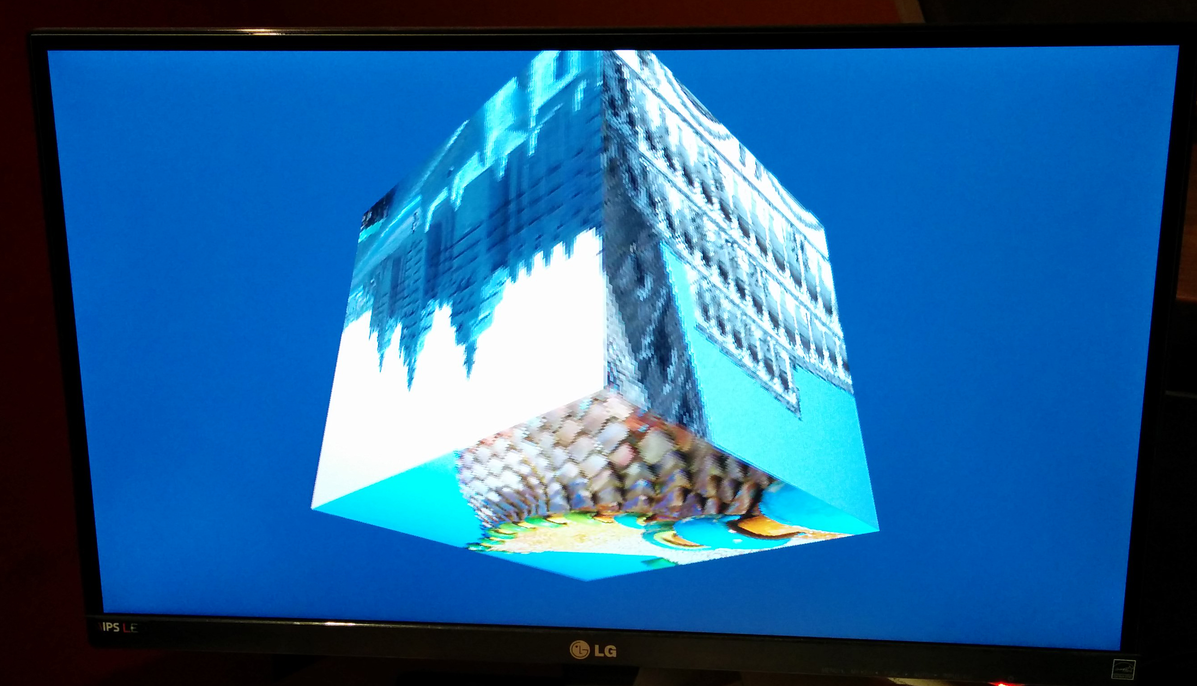
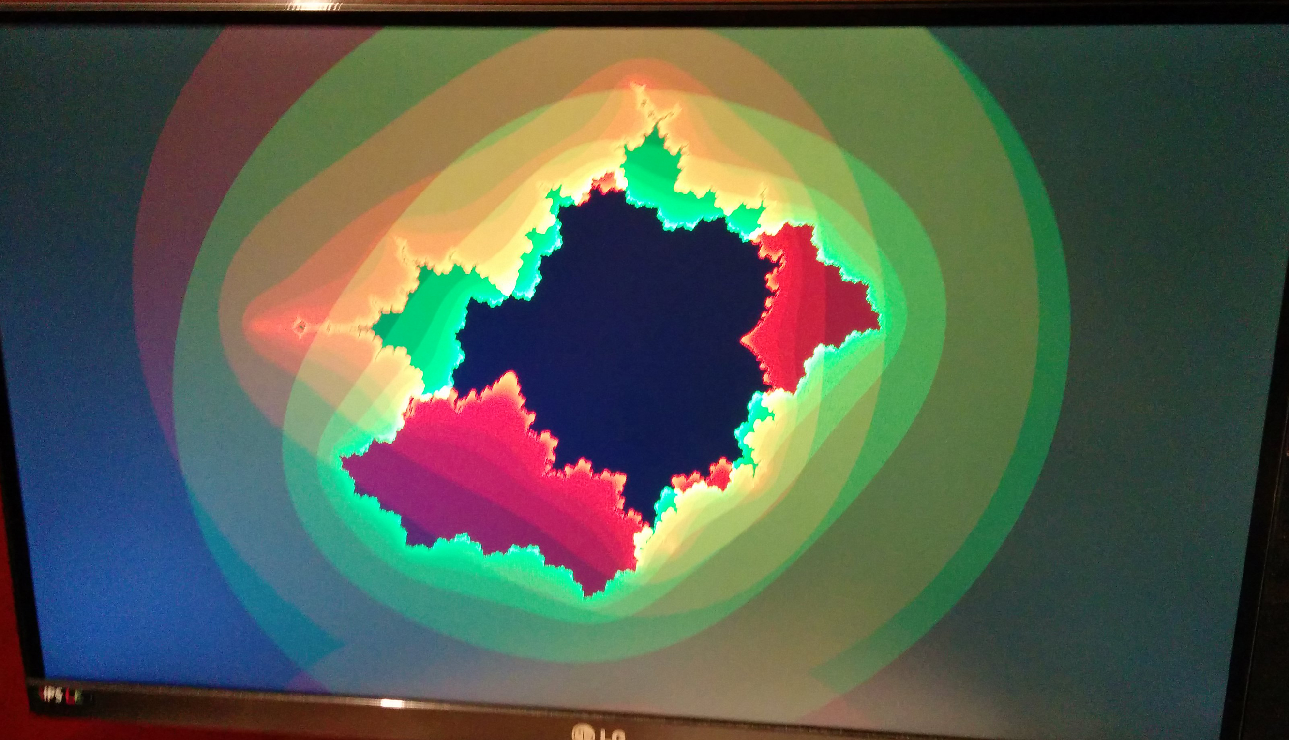
Raspbian demo’s / tests
H264 video
Triangle test
Triangle test 2

Slide 6
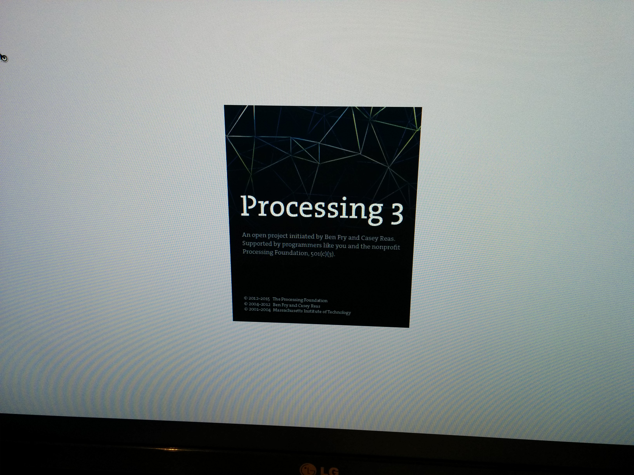
Introduction to Processing 3
First sketch
Other shapes
Make things move
Respond to the mouse
Drawing ellipses with mouseDragged

Slide 7
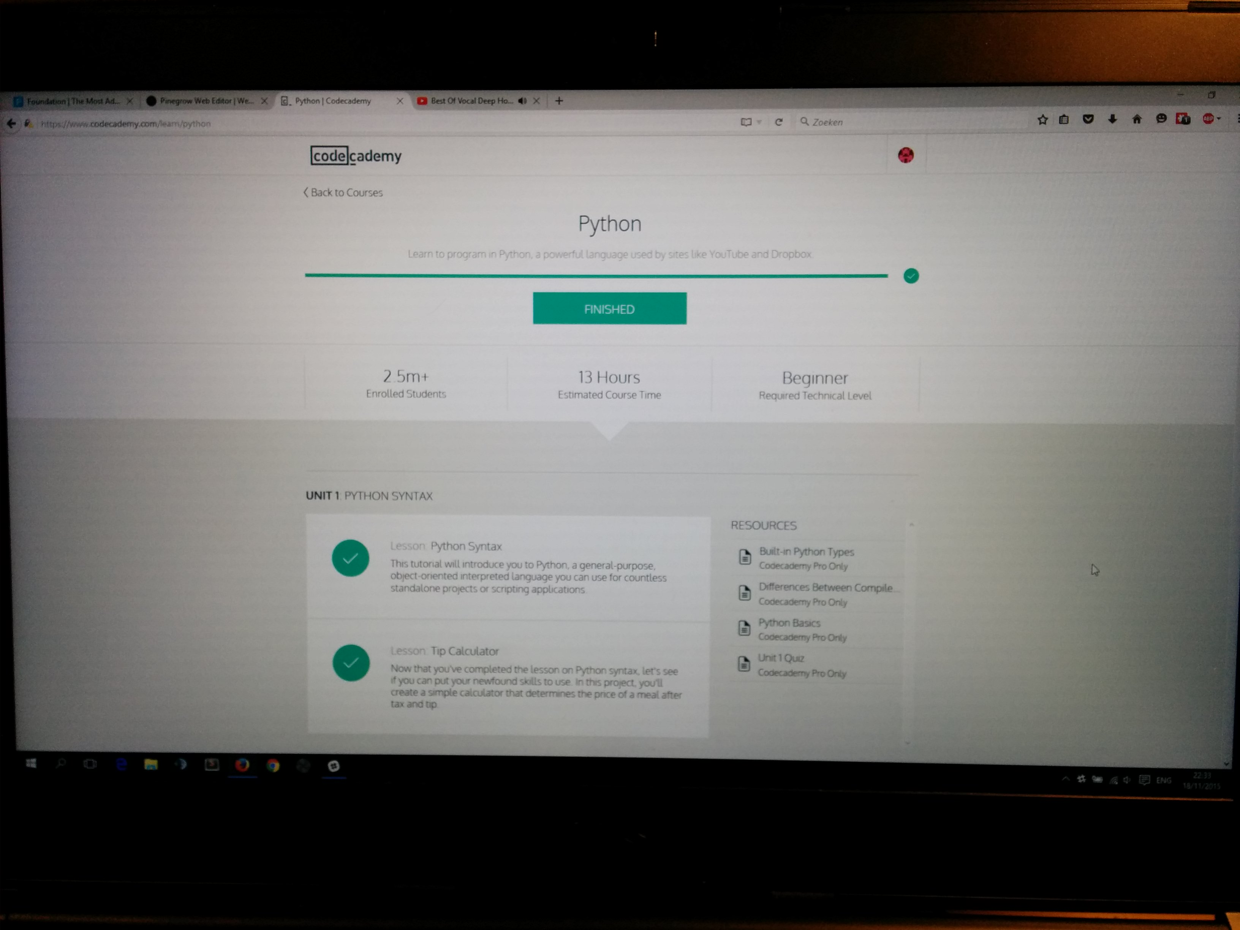
Codecademy: Python Basics
Battleship
Exam statistics
Classes – inheritance
Classes – overriding methods
Classes – useful classes
Files – input / output

Slide 8
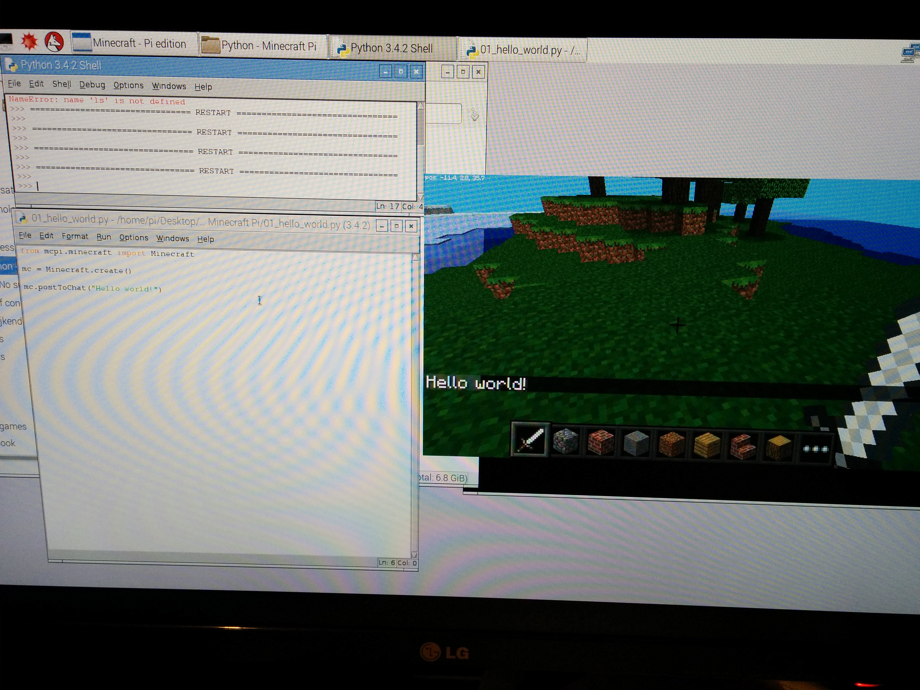
Minecraft Pi
Hello world
Teleport player
Set block
Set multiple blocks
Dropping blocks as you walk
Playing with tnt blocks
Fun with flowing lava

Slide 9
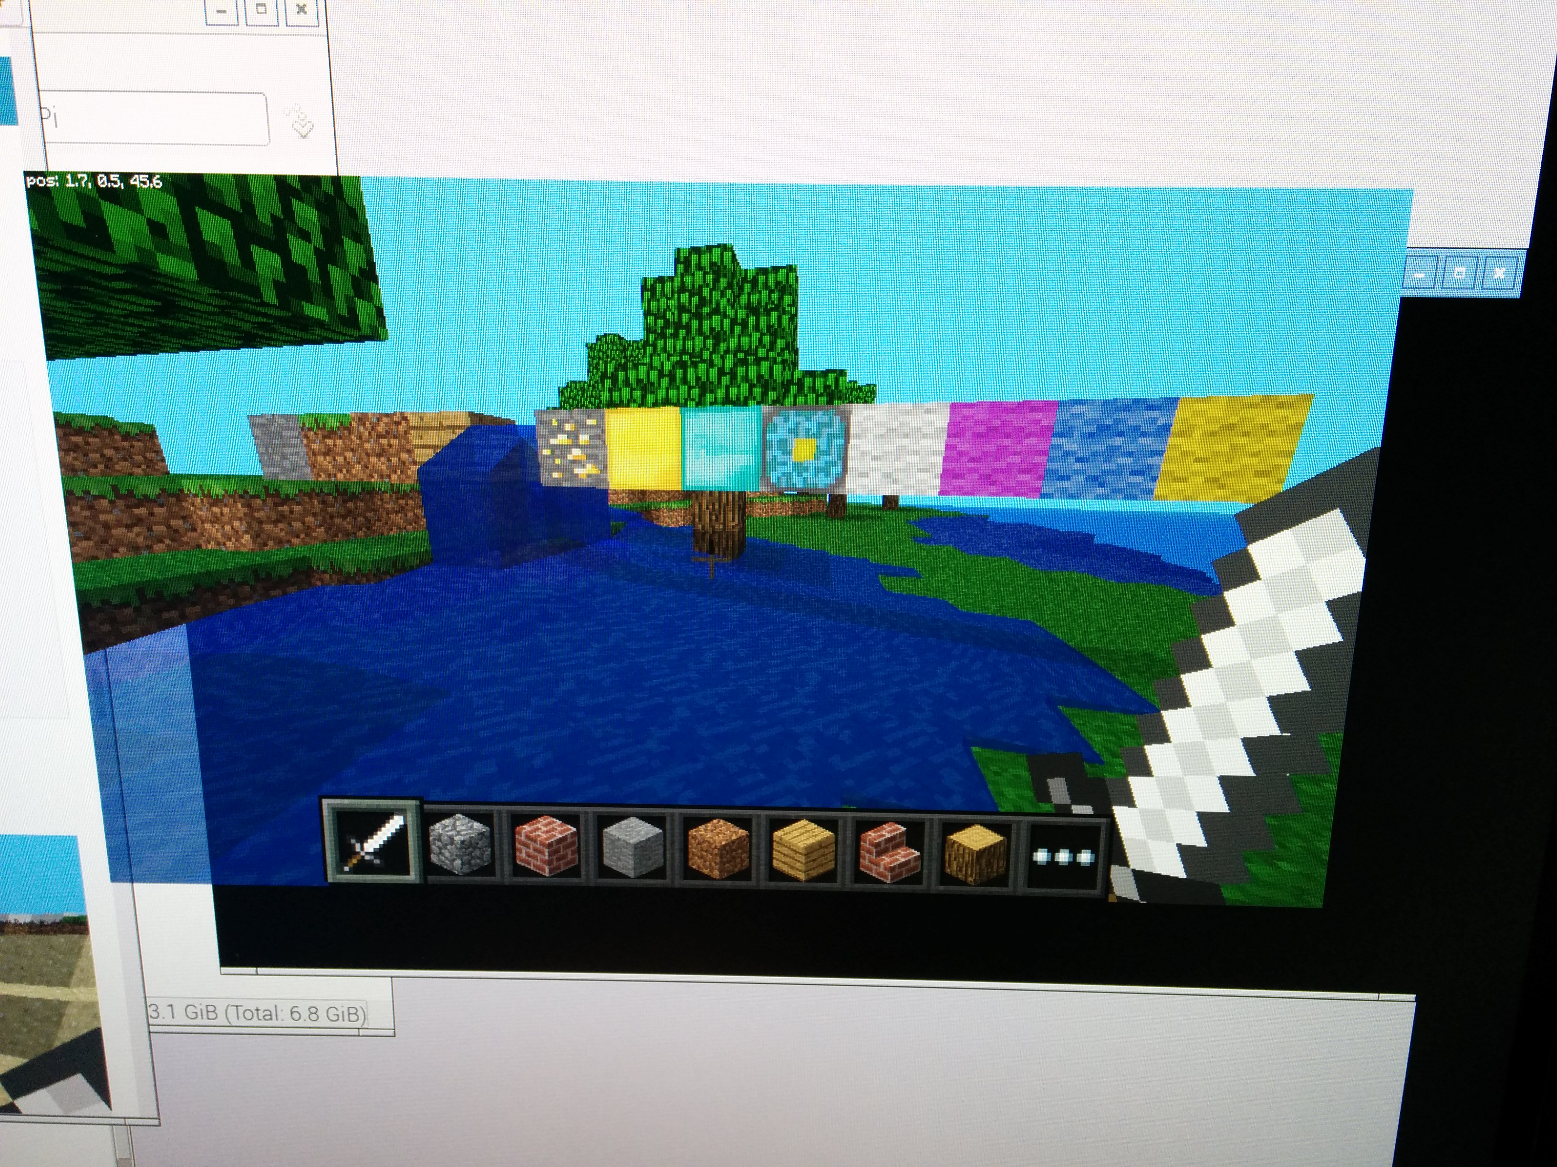
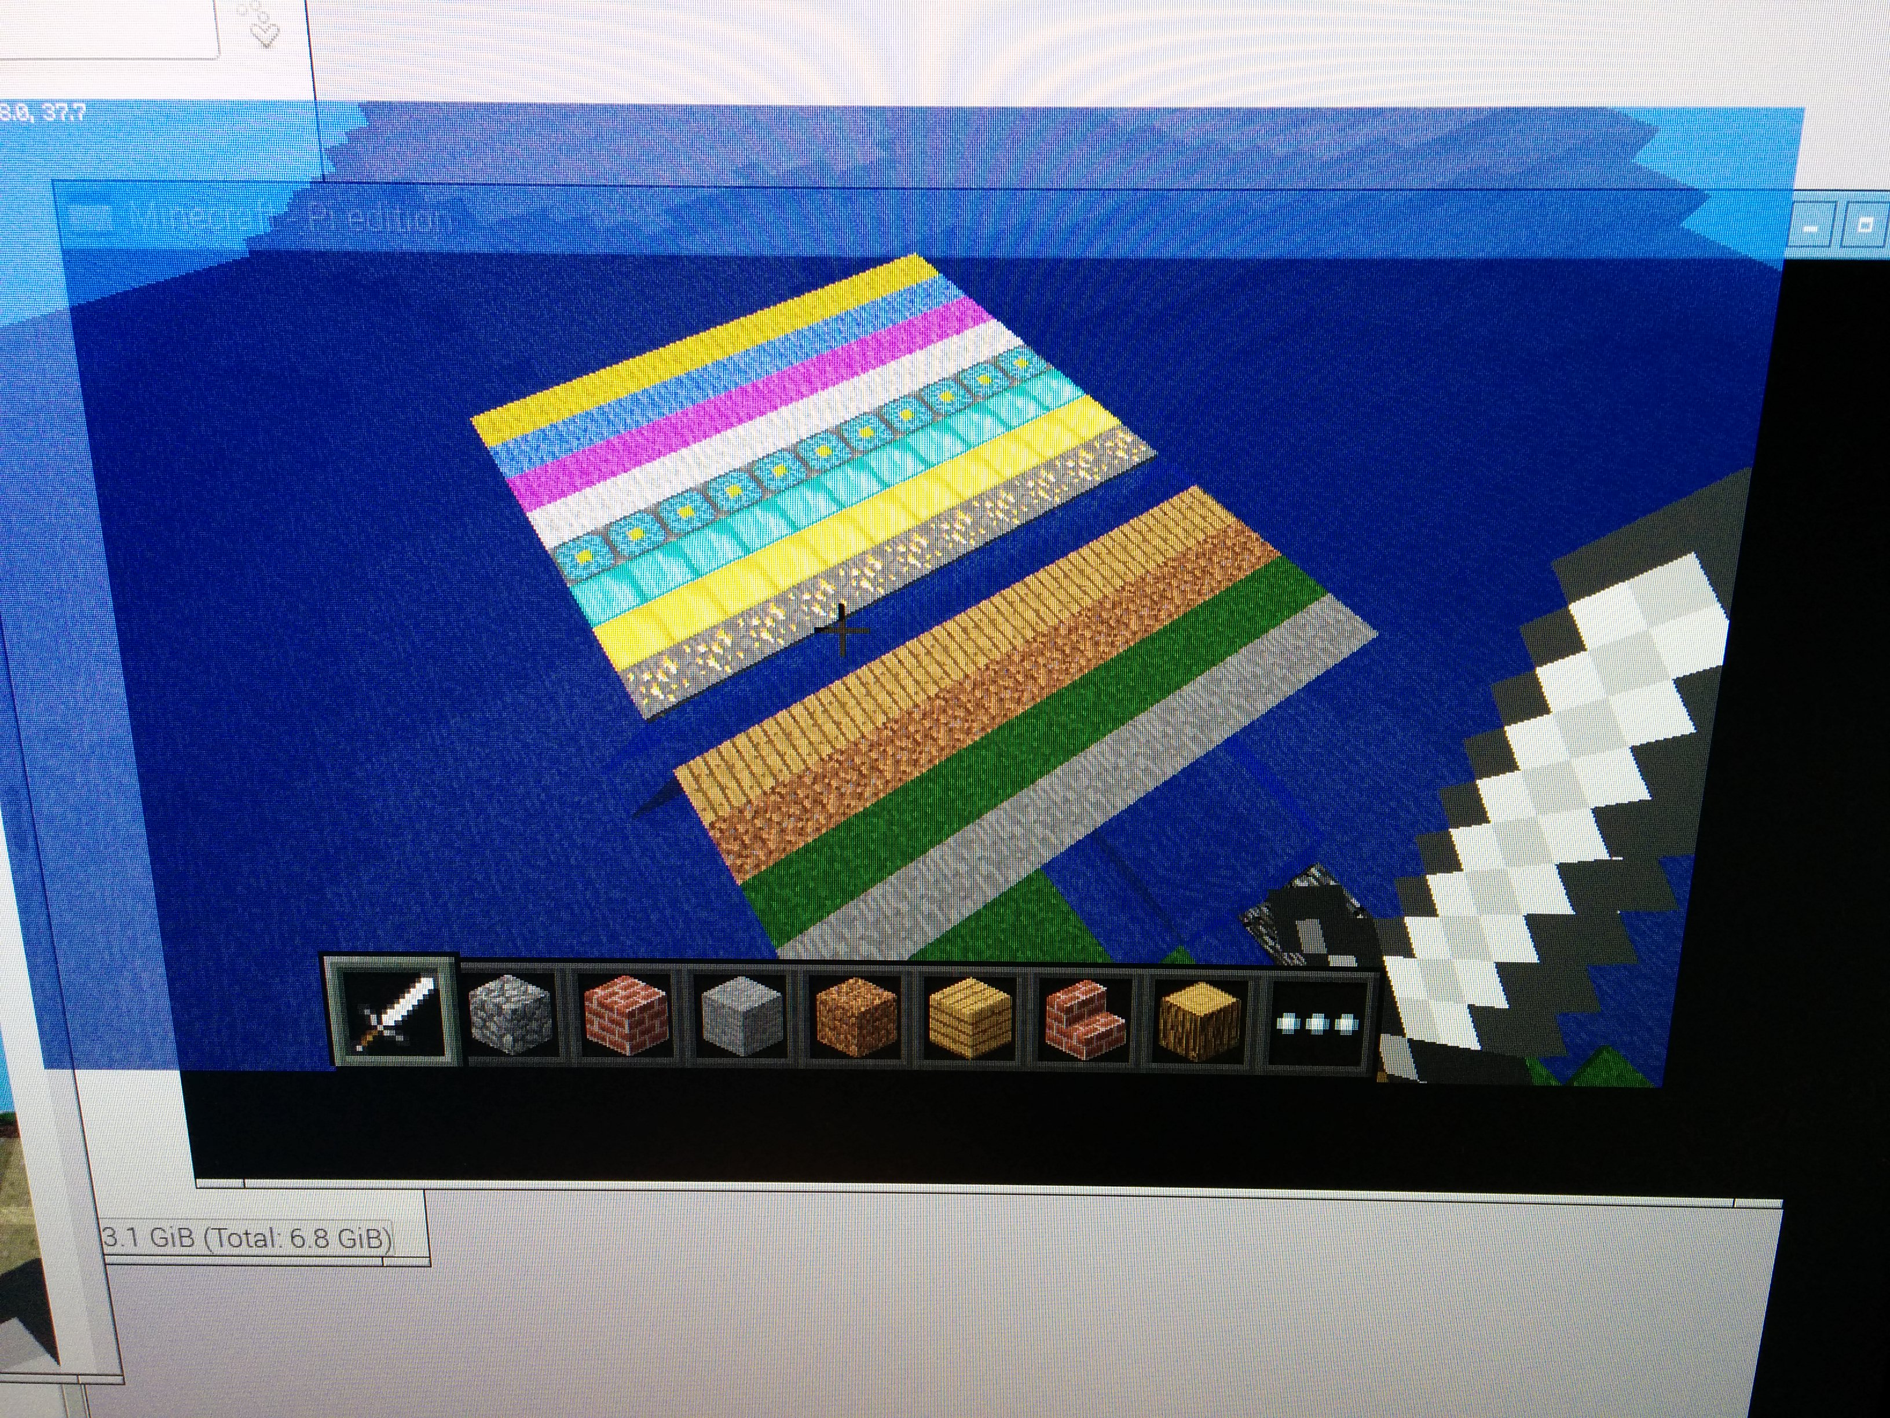
Minecraft Pi: Set multiple blocks

Slide 10
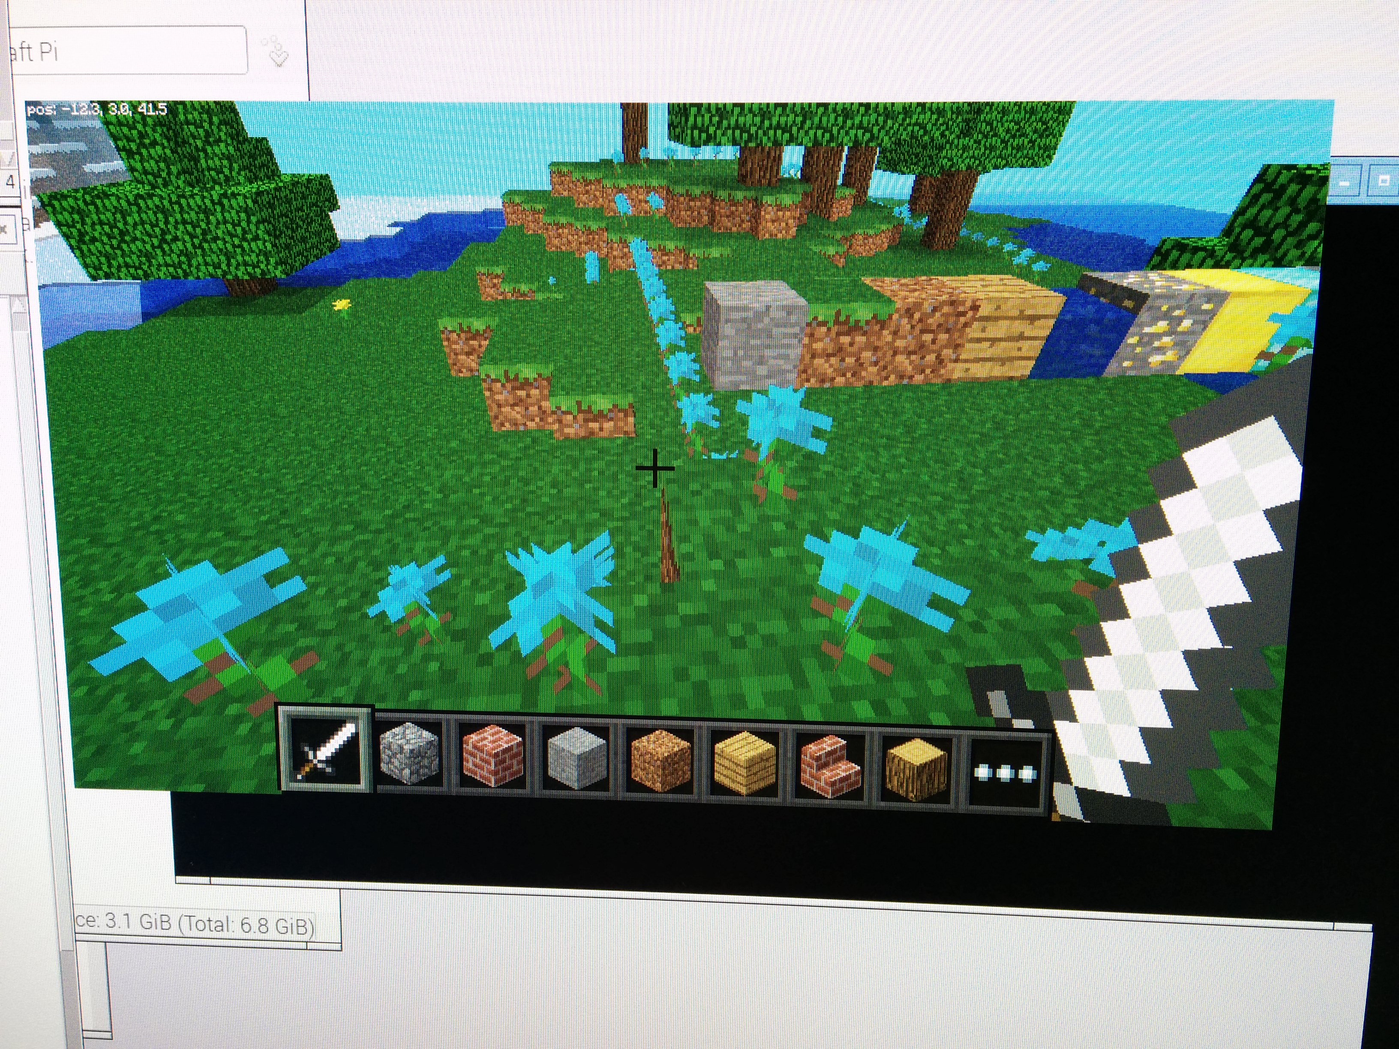
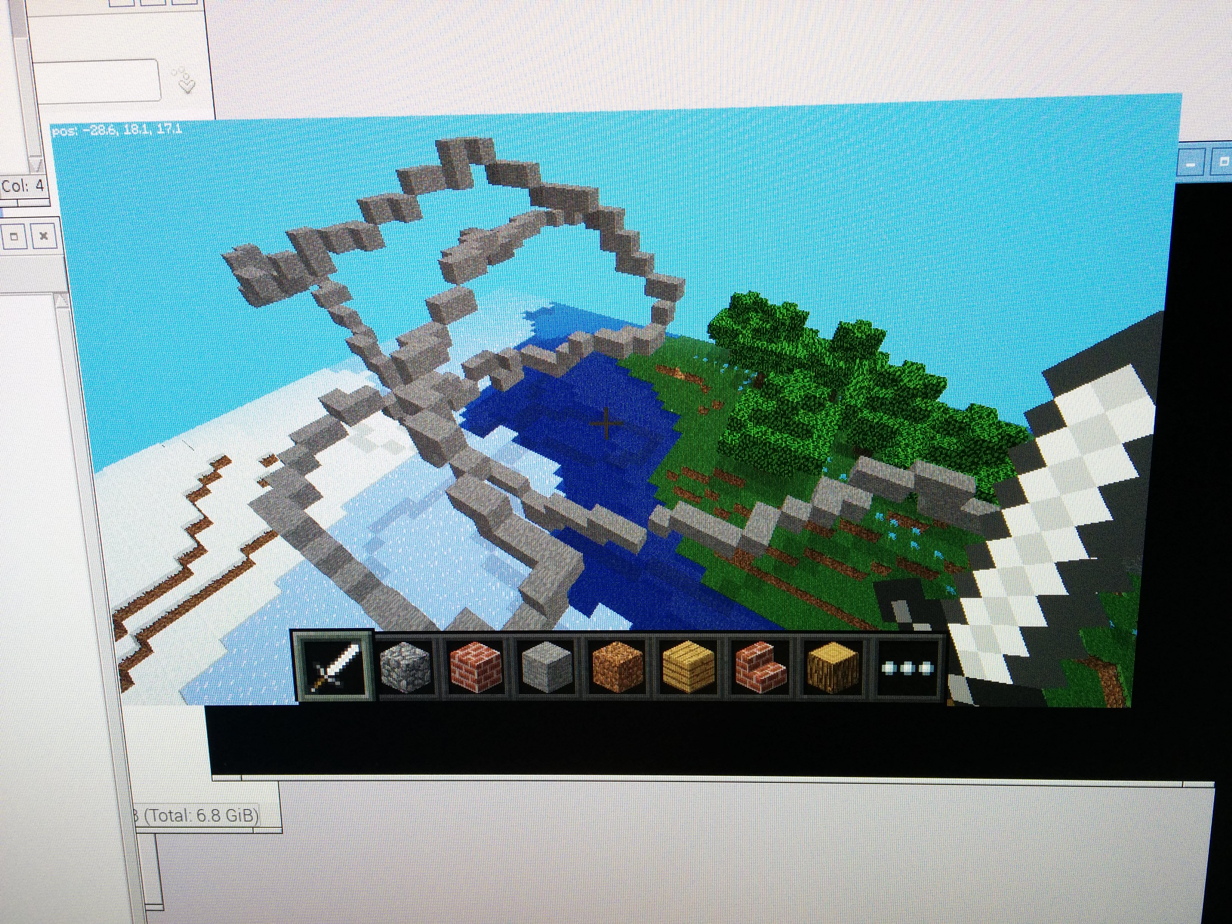
Minecraft Pi: Dropping blocks as you walk

Slide 11
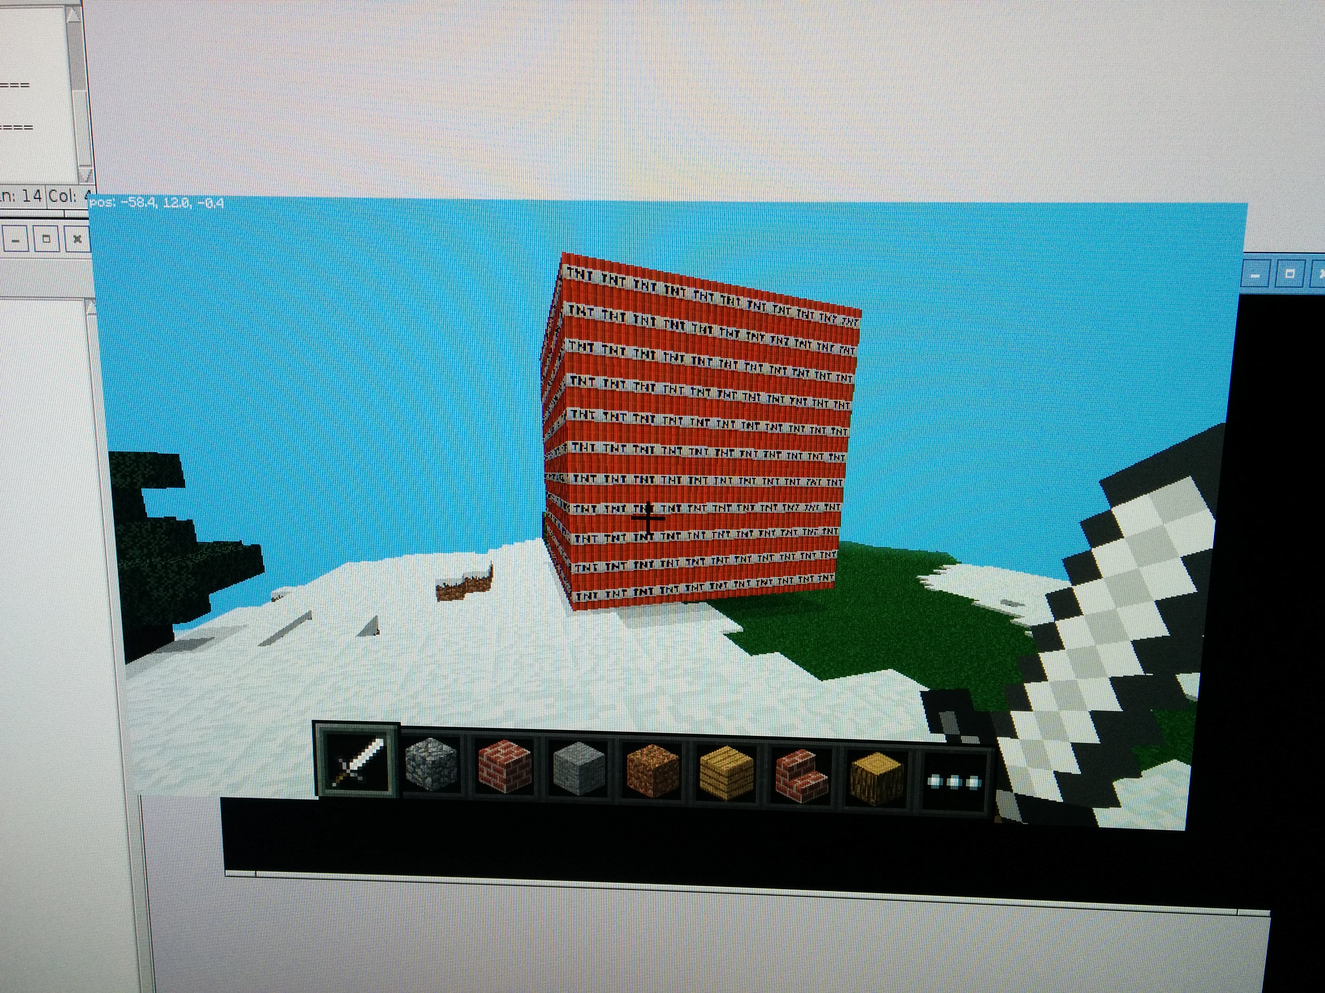
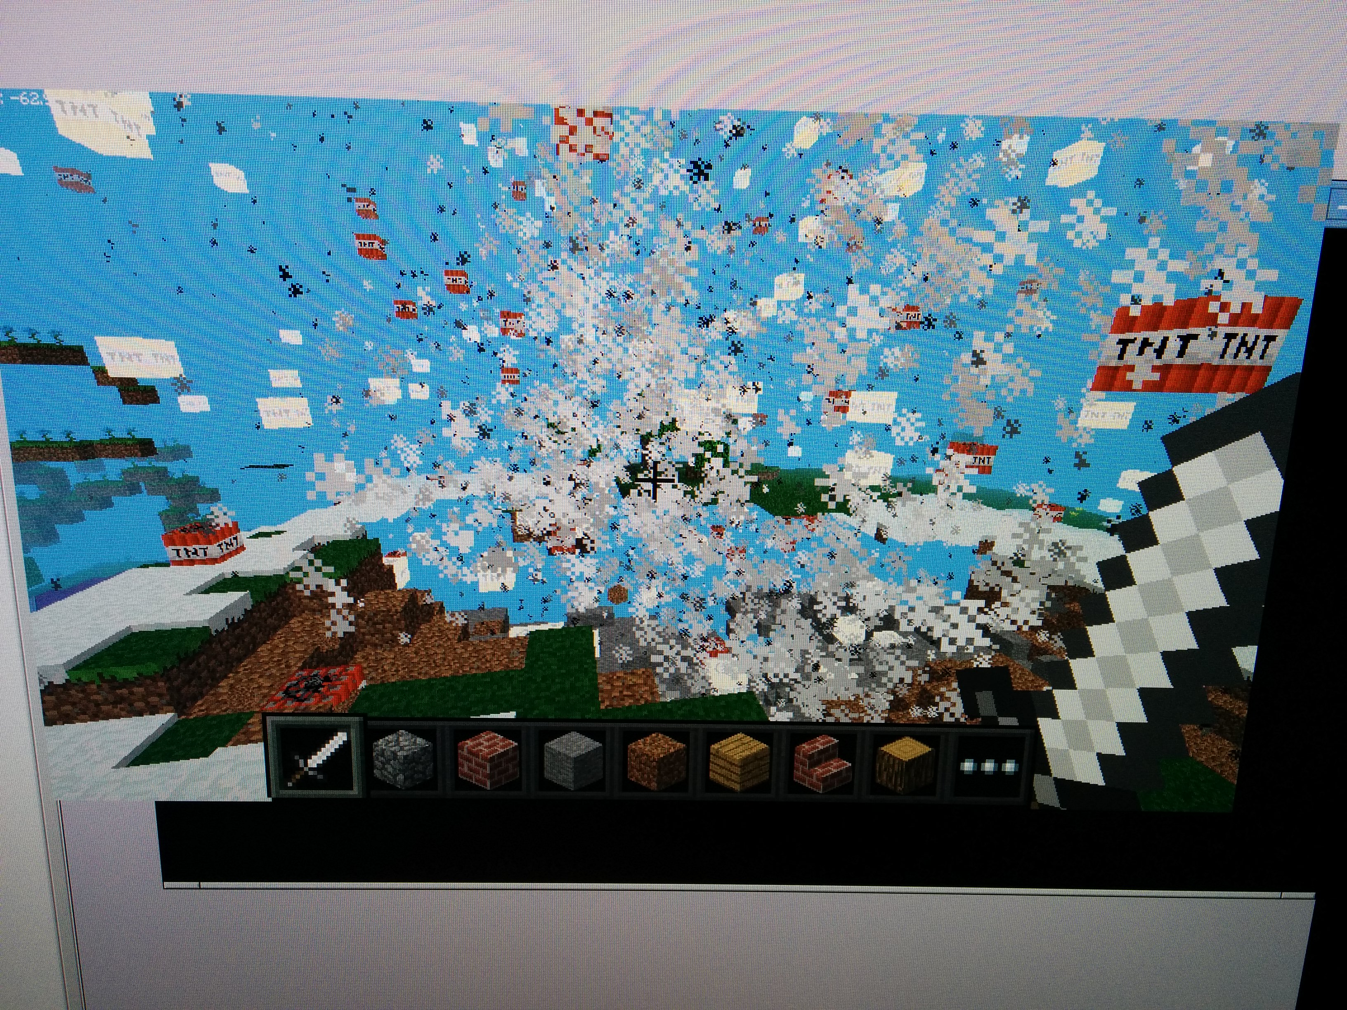
Minecraft Pi: Playing with TNT

Slide 12
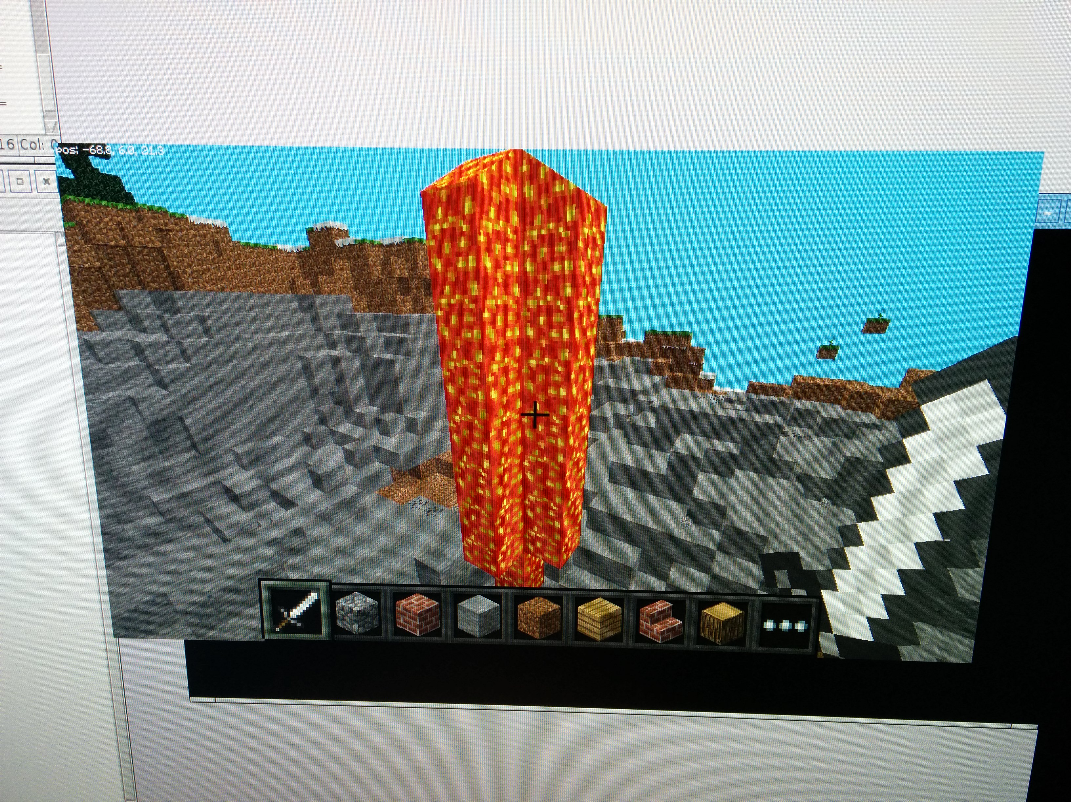
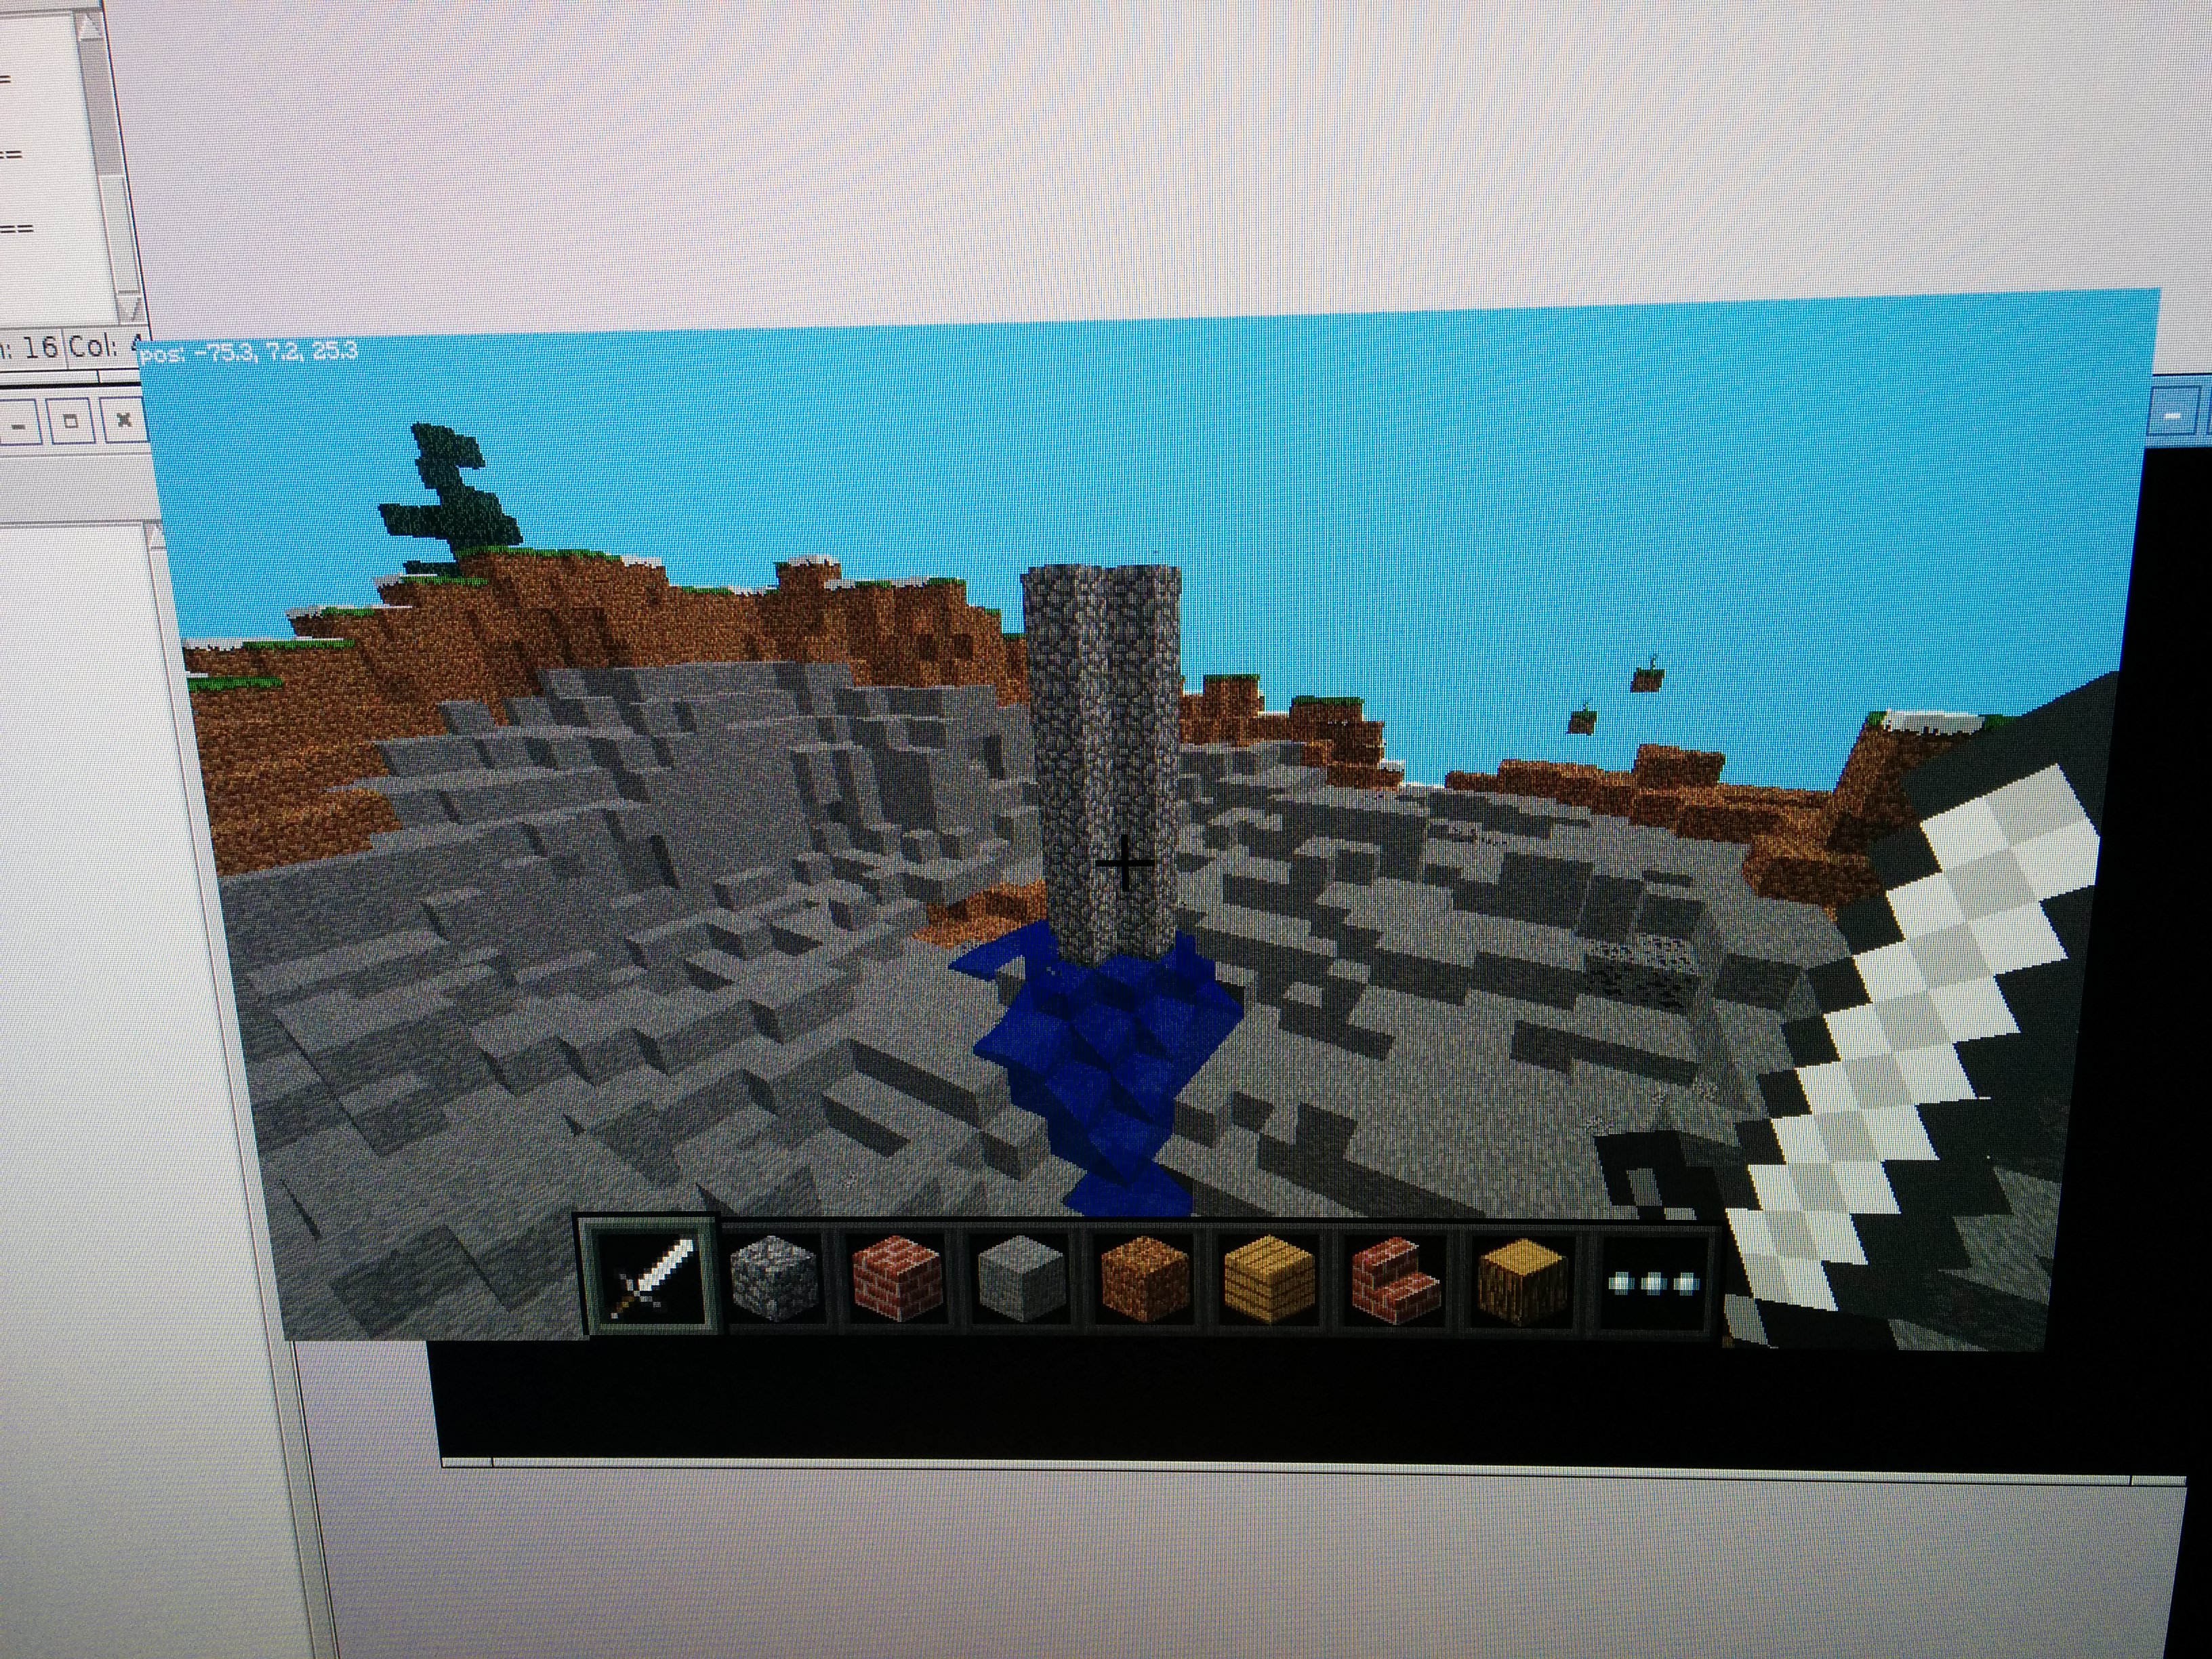
Minecraft Pi: Fun with flowing lava

